Slide 1
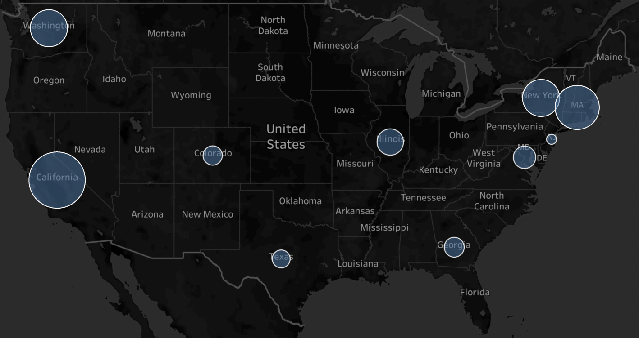




By
Data Wranglers
73% of data jobs in Massachusetts are data scientist positions
Firms in Colorado are mostly hiring people with 4-8 years of experience
74% of jobs in Washington are data jobs
Hottest data job markets in the
United States
8% of vacancies in Texas require machine learning skills
California has the highest number of data science vacancies, 30% are data jobs
by
Data Wranglers

